Slide 1
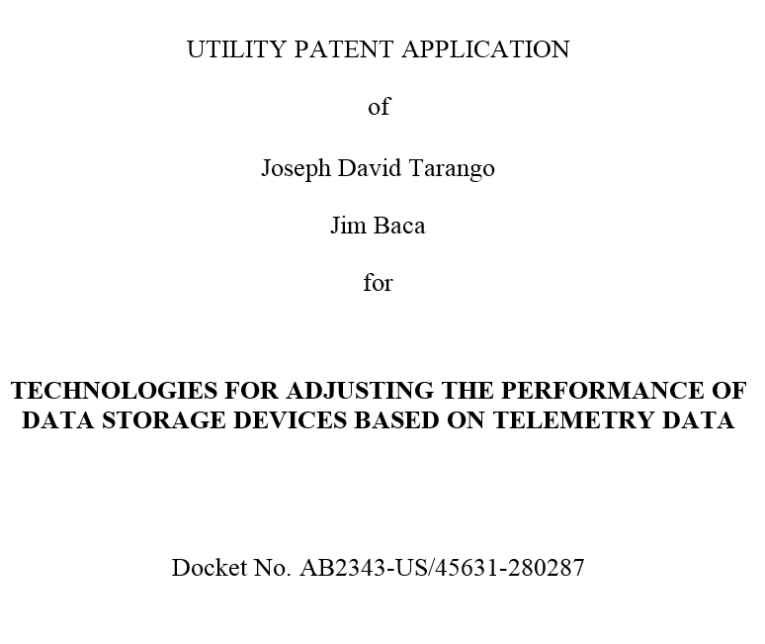
Intel® Autonomous Machine Programming Ecosystem for Rapid Execution
Presenter(s):
Joseph (Joe) Tarango
Jim Baca
Special thanks to everyone with possibility thinking making the telemetry tech possible!
Notes:
Hello Everyone,
I would like to take the opportunity to present a joint effort with many supporters, Intel AMPERE. The technologies are based in storage and are transferable to other adjacent technologies. Many of these technologies are patent pending being Intel exclusive technologies.

Slide 2
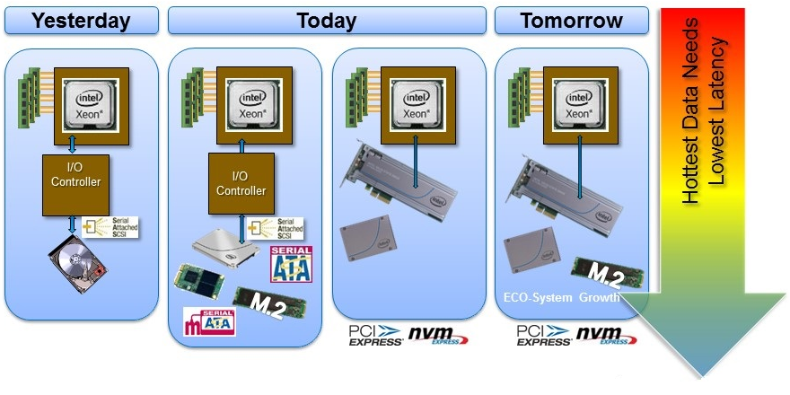
Table of Contents
Storage Devices (Intel SSDs)
Background
Challenge(s) for Scalability
Motivation and Opportunity
Identify Purpose
Transforming the Industry
Specification Addition(s)
Fundamentals of Telemetry
Notes:
Today we will cover, the background, motivation, opportunities, purpose, and fundamentals.

Slide 3
Table of Contents
Innovate and Automate
Cross Language Compiler
Data Exchange Model and workflow
Application for Rapid Triage
RAAD
Machine Programming
Before and After Vision
High level Diagrams
Notes:
The content expands to new innovations in automation through pathfinding by accelerating productization. The effort being conducted today is based on Telemetry Meta data.

Slide 4
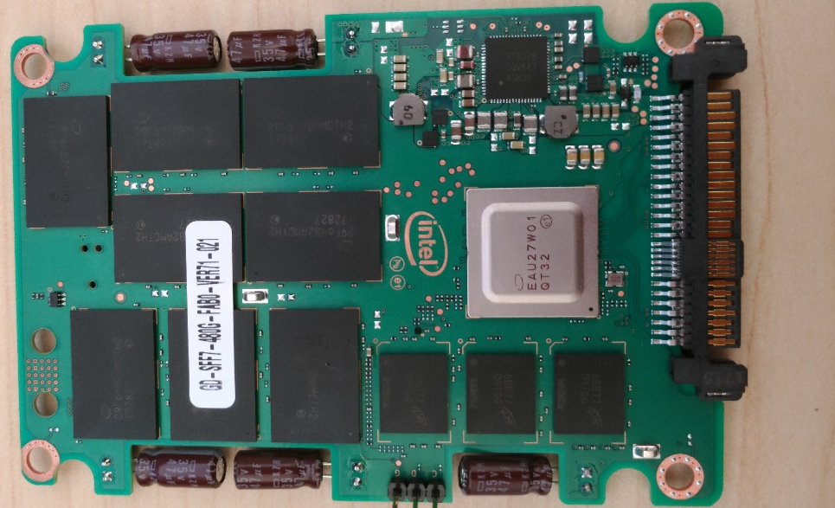
Storage Device Background
HDD Mechanic(s)
Actuator / Servo
Spindle / Motor
In an HDD vs SSD design, we must overcome all disadvantages:
Ruggedness – HDD not so good; SSD excellent: no mechanical parts
Read – HDD fast; SSD very fast: no mechanical delays
Write – HDD fast; very slow (NAND), very fast (Optane)
Erase – HDD doesn’t even need; very slow (NAND), very fast (Optane)
Addressing – HDD very slow; NAND blocks and pages, Optane uses row column access.
Longevity – HDD okay; Nand & Optane has limited erases and read retention, a trade-off for better cost
Power – HDD okay; SSD better
Scalability – HDD poor at small; SSD better and market is limited
3-30K RPM
Actuator Arm
Read / Write Heads
Disks / Platters
(2 magnetic surfaces each)
SSD Mechanic(s)
JTAG Debug
Caps, Power Loss Protection
Media, NAND or Optane
Power Management
(PMIC)
ASIC SOC
PCIe Interface
DDR, Firmware Meta Data
Notes:
To start off, we would like to explain the mechanics of storage and contrast the features. The image to the upper left is an HD and the majority of the components are mechanical in nature; in contrast the image in the lower left corner is an SSD with no moving parts. The technology driver is our system construction on our media technologies (NAND, and Optane). The highlights of SSDs are they are faster, scale, provide lower power at higher performance. The disadvantages are longevity due to background data refresh and solid state physics.

Slide 5
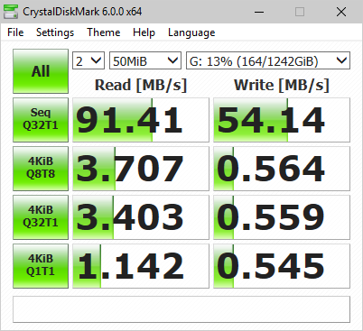
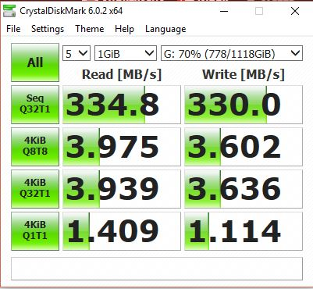
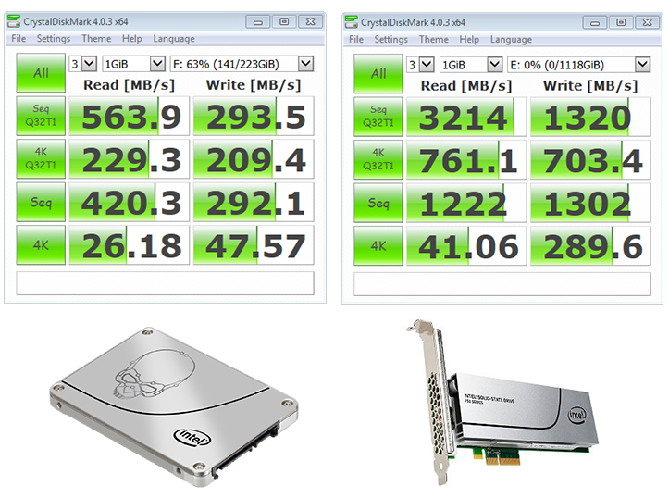

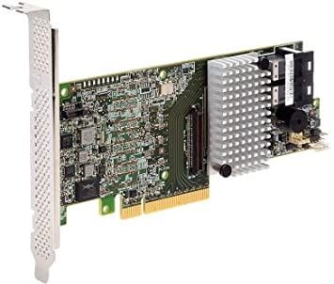
Storage Technology
Storage Device Type(s)
HDD = Hard Disk Drive
Protocols: (SATA, SAS)
SSD = Solid State Drive
Protocols: (SATA, SAS, NVMe)
Protocol(s)
Serial Advanced Technology Attachment (SATA)
Chipset or Add-in cards
Serial Attached Stands for SCSI (SAS)
Chipset or Add-in cards
Small Computer System Interface SCSI “scuzzy”
NVM Express (NVMe)
Virtual layer on PCI Express (PCIe) bus
SATA
SAS
SATA
NVMe
Notes:
With each of the main storage devices, we have several protocols with the overhead limitations of SATA and SAS being a bottleneck for current computing. The introduction of NVMe over PCIe integrates the hardware acceleration directly to the CPU and NiC. From the storage benchmarks in the upper right hand corner, we ca see as we transition from SATA to NVMe we achieve significant speedup overall with higher throughput and lower latency.

Slide 6
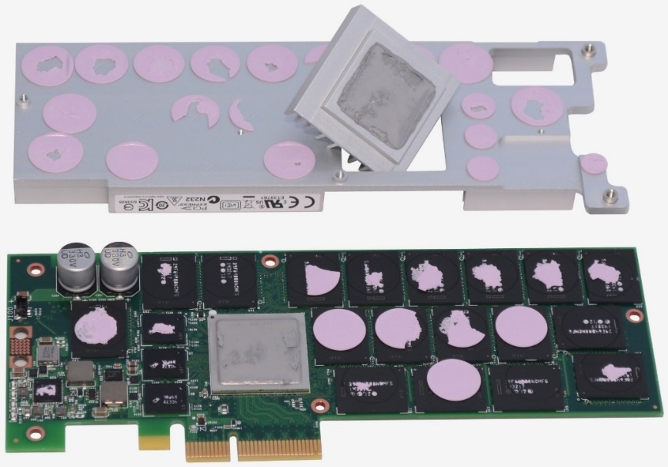
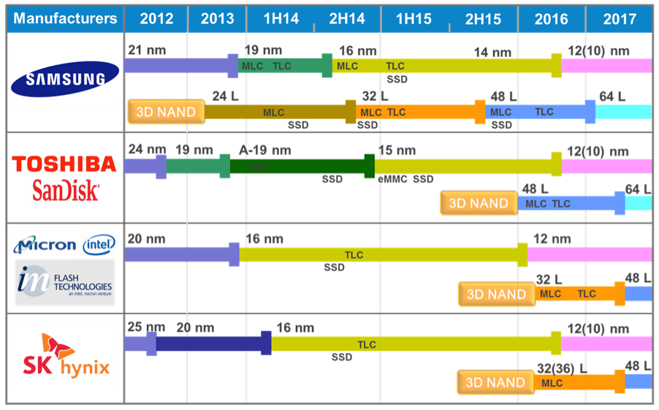
SSD Development Policies
Performance
Native command queuing and flash parallelism
Garbage collection and block picking
Reliability
Enhancing the media
Error recovery
End-to-end protection
Read disturb management
Temperature management
Endurance
Designing firmware for endurance
Life curve throttling
Security
Flexibility
Mapping strategies
Design for media flexibility
Power modes
Notes:
Due to the complexities of integrating several solid state technologies and policies of media; we introduce required complexity to meet customer standards. The policies on the left are all of the considerations in developing a SSD and the implementation requires experts to traverse the landscape. The image in the center is an example system hardware diagram of the SoC from patented technologies. The technologies have disrupted the industry so much that there are many vendors for solid state media to meet customer demand. Our response, quality, and ecosystem is the differentiator from all other vendors.

Slide 7
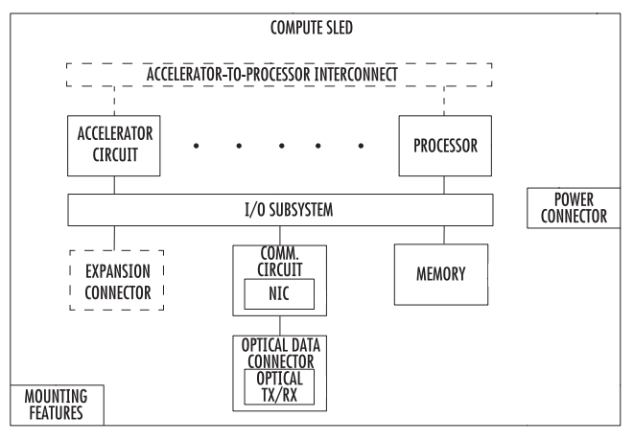
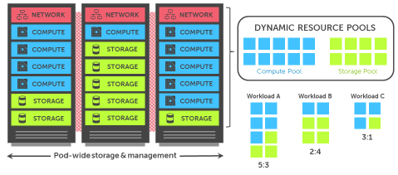
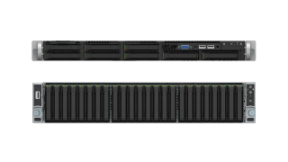
Heterogeneous Compute Synergistic Rack(s)
Hardware Modules
Compute
FPGAs
GPUs
CPUs
Customized
Memory
Cache
Swap
Warm Storage
Cold Storage
Deep Storage
Intel® Server Board S2600WF-Based Systems.
Notes:
When looking at the system, we can see our storage devices are integrated to many layers of our compute ecosystem. With the tight integration, we introduce a wholistic solution only intel can develop end to end. The challenges associated with the tight integration are related to the handling of all positive and negative system interactions to optimize the up time of the server.

Slide 8
Storage: Motivation and Opportunity
For in-field anomaly events, customer characterization data was insufficient to root cause in a timely manner.
Other Customer Disruptions :
Drive being sent back to Intel/ Onsite AE Support
Vendor Unique (VU) commands used to pull Triage Log
Scope for human error in pulling relevant logs
Content extraction in field requires special tools - Overhead for unlocking drives, limitations of internal tools in field.
Customers were dissatisfied with this overhead.
Being customer-obsessed: Reduce overhead by collecting the data in the least intrusive manner with one mechanism.
Notes:
Minimize the returned Intel devices in the field
Complex propriety tools are no longer required
Eliminate (or minimize) the need for customers to remove drives from their systems to retrieve logs (no more ship to Intel and AE-in-a-box onsite to retrieve logs)
Accelerate debug of sightings, both internally (ConVal and PV) and externally filed (Customer)
Internally (Continuous Validation and Platform Validation)
Externally (OEM and Customer)
When a challenge is not clear provide feedback for how we can improve the methodology in future engagements

Slide 9
Identify Purpose
Time-to-Data (TTD): the determinate timeline from anomaly appearance to the confirmation of adequate evidence to proceed a technical resolution strategy
TDD was in the range of 2-3 weeks to months! Thus, Time-to-Data (TTD) is what telemetry initiative tries to optimize.
Innovate One-Intel solution with mechanism(s) to:
Capture and save all data in a persistent manner using available data dumps
Automate end to end data interpretation for expedited response
Diligently develop a problem statement using the scientific method by reducing scope
Develop the NSG anomaly analysis handbook for reliable responses
This will decouple dependencies and accelerate analysis of anomaly event detections (both internal and external)
Notes:
The purpose of our effort was to optimize the time to data in order to resolve customer queries with precise technical information.

Slide 10
Transforming the Industry Influencing Storage Standards

Slide 11
Telemetry Specification
Standardizing command interface for all current and future products
NVMe 1.3 Telemetry Specification
SATA ACS 4 Definitions
Intel defining industry standard - same Telemetry command for all drives
also removing the need to unlock the drive since we issue standard commands.
Intel has decided to use the NVMe 1.3 Telemetry specification as a basis for all products
Both NVMe and SATA Telemetry specification defines that the page return data contains:
Standard header specified
Data requested must be multiple of 512 Bytes
Up to three consecutive data areas
Notes:
Telemetry is increasingly viewed by our customers as a critical drive debug aid worldwide.
NSG Telemetry Working group worked across all zilos(?) and solicited customer feedbacks - Customers Reqs drove Specs,
Availability of Customer own tool chain interface to retrieve logs in customer environment (Linux, Microsoft Windows, …)
Uses generic tool commands; Same Telemetry command for all drives - Also, no need to unlock the drive since we issue standard commands)
Both specs define 2 new log pages: Host Initiated Telemetry Log (log page identifier 0x07) , Current Device Internal Status Data Log (log address 0x24)
Controller Initiated Telemetry Log (log page identifier 0x08), Saved Device Internal Status Data Log (log address 0x25)
be dynamic
We defined what internal data needs to be packaged into the telemetry data sets.
Standardize, Externalize (Proprietary but not dependent), Accelerate, Dynamic Table of Contents, Remove Roll versions, Self-describing data allows Flexibility and New, Prevents

Slide 12
Telemetry Fundamentals

Slide 13
Telemetry Fundamentals
We defined what internal data needs to be packaged into the telemetry data sets
The data list, values, and details are dynamic so the content can be customized per usage
Telemetry is a method to request and extract data. It includes 2 steps:
Pulling / extracting / collecting the information
Parsing the information - a disjoint technique related to the auto parser (Telemetry does not do any analysis)
In-field Use-cases
Single Event Telemetry Data Pull
Drive indicates an anomaly via Controller Initiated Event (CiTac Asynchronous Event)
Drive fails and host pulls a dynamic log through Host initiated (HiTaC) Query
Periodic Healthy Drive Telemetry Data Pulls : Healthy logs archived by customer and can be contrasted against the failure when it arrives
Notes:
Easy Data Extraction, Not Unlocking Drive. Intel, Micron, Samsung can all have standard. Data payloads intelligent design, prescribed struct, content dymanic. Proprietary Intel Data Construction, Not Spec,
Use Cases, host (1 and 2), periodic is for host,
Define and Deliver Above Expectations

Slide 14
Content, Data Objects, and Magnitude
The Telemetry log can consist of 3 data areas:
Data Area 1 (Fast Analytics):
Small in size, designed for periodic pulls during operation, contains critical drive data, one command
Data Area 2 (Extended Analytics):
Medium, scale up included content, multiple commands
Data Area 3 (Complete Snapshot of Meta Data):
Large, designed to be comprehensive
Data Area | Objects | Section Size | Content
1 | 32 | 100 KB | Drive Configs, Stats, Media, Core, Analytics, Nlog Partial
2 | 41 | ~2MB | Configs, Stats, Transport, Media, Debug Full
3 | 200 | 29.8 MB | Event Dump, nLogBufPool Full, Analytics, APL
Note(s)
The architecture is designed to be dynamic thus the objects are subject to change over time.
Data area sizes are dynamic
Notes:
None of the data areas have a fixed size. There is a target limit on data area 1 for Host Initiated of 100KBytes and there is a hard limit of 31.9MBs for the command, but the actual data area sizes are dynamic.
Fast, extended, complete. Dynamic, Don’t mention ML, Systematic Analysis Through Telemetry (RACE)

Slide 15
Data Control Centralized Tracking and Management for All Products

Slide 16
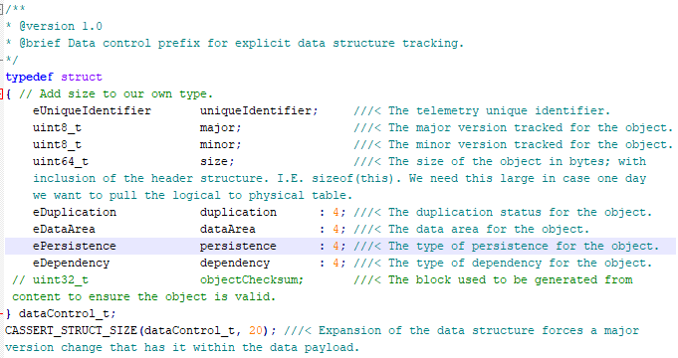
Data Control - Identifier and Tracking
Data Identifier requirements:
Every data must be tracked via UIDs:
Major, Minor, Size
When new structures are added to Telemetry, it requires new assignment.
UIDs are not reusable ( agnostic to retiring structures)
Metadata tracked for every data identifier:
Unique Identifier | Telemetry Version | Autoparsable in Product, [Sub-Builds] | Major | Minor | Persistence | Dependency | Security Classification | Byte Size (Decimal)
Data Area | Structure Duplication | Data Object Group | Global Name | Size (Hex) | Within Assert | Product, [Sub-Builds] | Domain | Owner | Description
Data Security Audit Process: Ensures that secure content embedded in the drive can’t escape (POC: Joe Tarango)
Notes:
Telemetry required its own standardized tracking data mechanism. With the introduction of telemetry, may new data structures were introduced. Every data object/identifier is self-describing here – UIDs are automatically assigned and generally take precedence over the human-friendly global name because of their uniqueness and non-reusability. Here, we show all the metadata tracked for every data identifier. Apart from the fundamental values for UIDS and major, minor, size fields – fields like security classification are of paramount importance. Description field along with product and domain fields throws light on the data structure’s construction, application and applicability to different products.

Slide 17
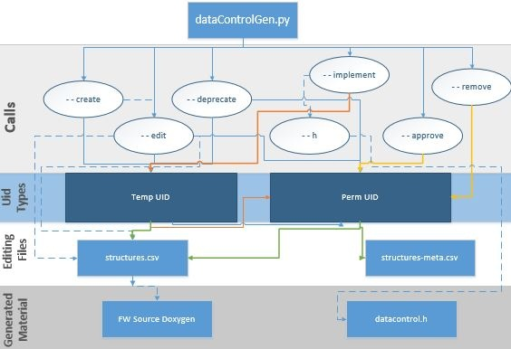
Data Control Management Methodology
Goals:
Reduce Erroneous Maintenance, Record Meta Data
Simple, Centralized Command Line Interface for Creation of New UIDs
Ensures Compatibility across Different Code Repos
Validates Input Types
Ensures no Duplicate UIDs Occur
Assigns Owners to Structures

Slide 18
Novel Data Consuming Effort Automating Decoders for Additional Content

Slide 19
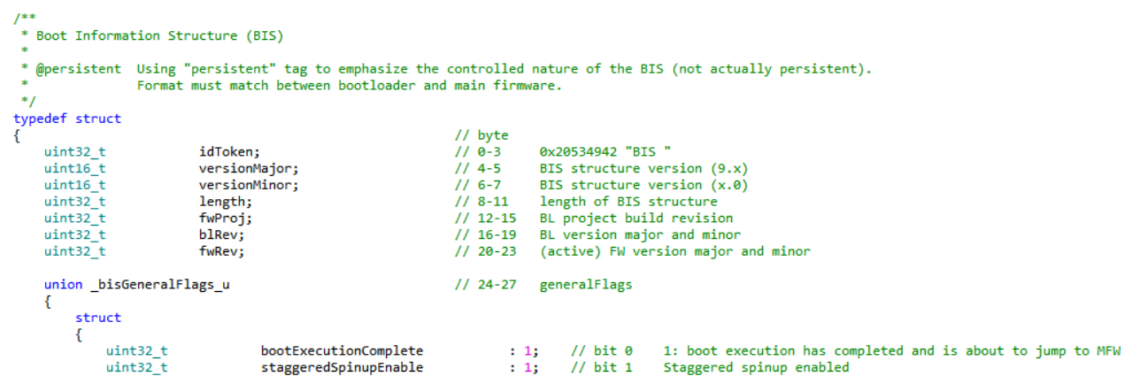

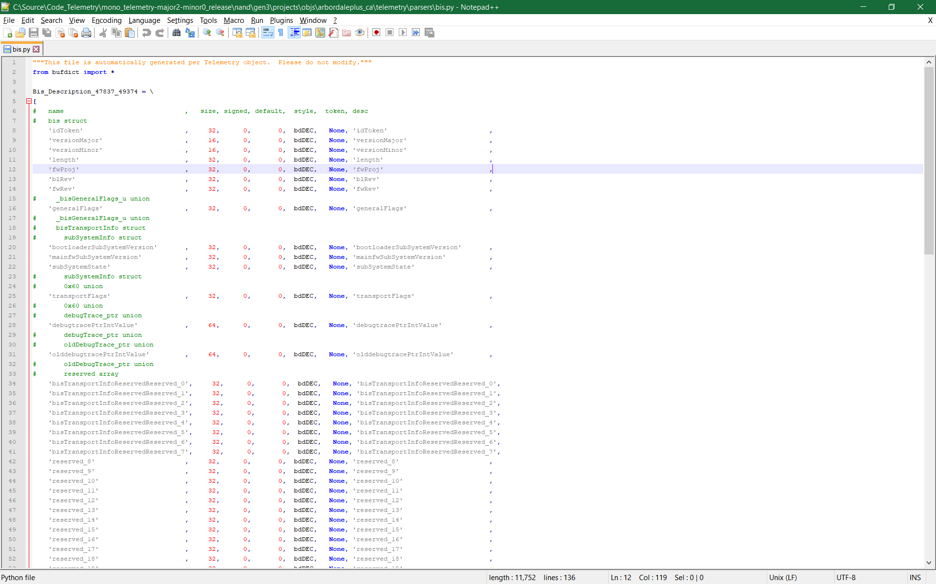
Innovative Cross Language Compiler
Data Transformation from C to Python C-Type
C/C++ to Python Cross Language Compiler Flow
Additional Support Includes
Python C-Types, Independent Classes, XML, SQL
Notes:
1, 2, 16, 17, Compile C to bring together all stakeholders at Intel. Python Ctypes, XML, SQL Auto Covert, Database, Tools etc consumability, No External Dependencies

Slide 20
Cross Language Compiler’s Impact in Development
Reduces the time for parsing coupled code by a factor of 48.73x for code to integration
Evaluation for a single telemetry object creation from C to python C-type:
Currently, with 288 Telemetry Objects Tracked, roughly 8,985,600 lines of code is needed to parse today!
Incremental delta of 2 weeks work, it would translate to roughly 11 years of work for parsing all objects!
Notes:
Time Save per Stages in Development. 48 Times Faster in Development. Necreased Documentation, No translation, Security Automated, LOG SCALE time save, Min Regression Testing, No Development, Autogenerate decoders for test commands..

Slide 21
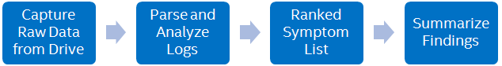
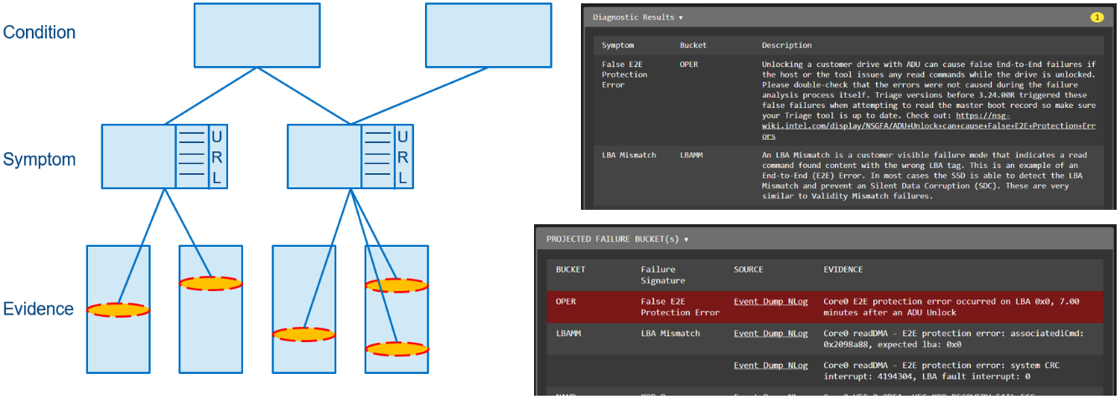

Automation Mining Telemetry for Rapid Triage
Data Decoding Flow
Goal(s) – Accelerate Decoding, Mapping, Analysis, and standardize Report findings of device to accelerate Engineers for internal and customer anomalies.
This is an end-to-end automation form data-extraction to triage and analysis.
Notes:
Compiler Map gens Simulation Scripts (straight GHS upload to Telemetry) , Library Saved, Report Created in Triage of Fault Areas, Automate Telemetry Payload Display. Internal and External Anomalies. Standardized Report to Customers Derived from Debug Handbook. Closed Jira, Update Handbook. Look for Fault Signature in Handbook, Debug Info.

Slide 22
Pathfinding Effort Rapid Automation-Analysis for Developers (RAAD)
NSG-STG, Intel Labs, and Universities
PI: Joseph Tarango
PM & PE: Jim Bacs
R&D: Justin Gottschlich
Universities: MIT, UCR, LeHigh, and many more…
Notes:
Next we introduce a joint pathfinding effort to integrate the technologies of machine programming with rapid analysis to empower developers.

Slide 23
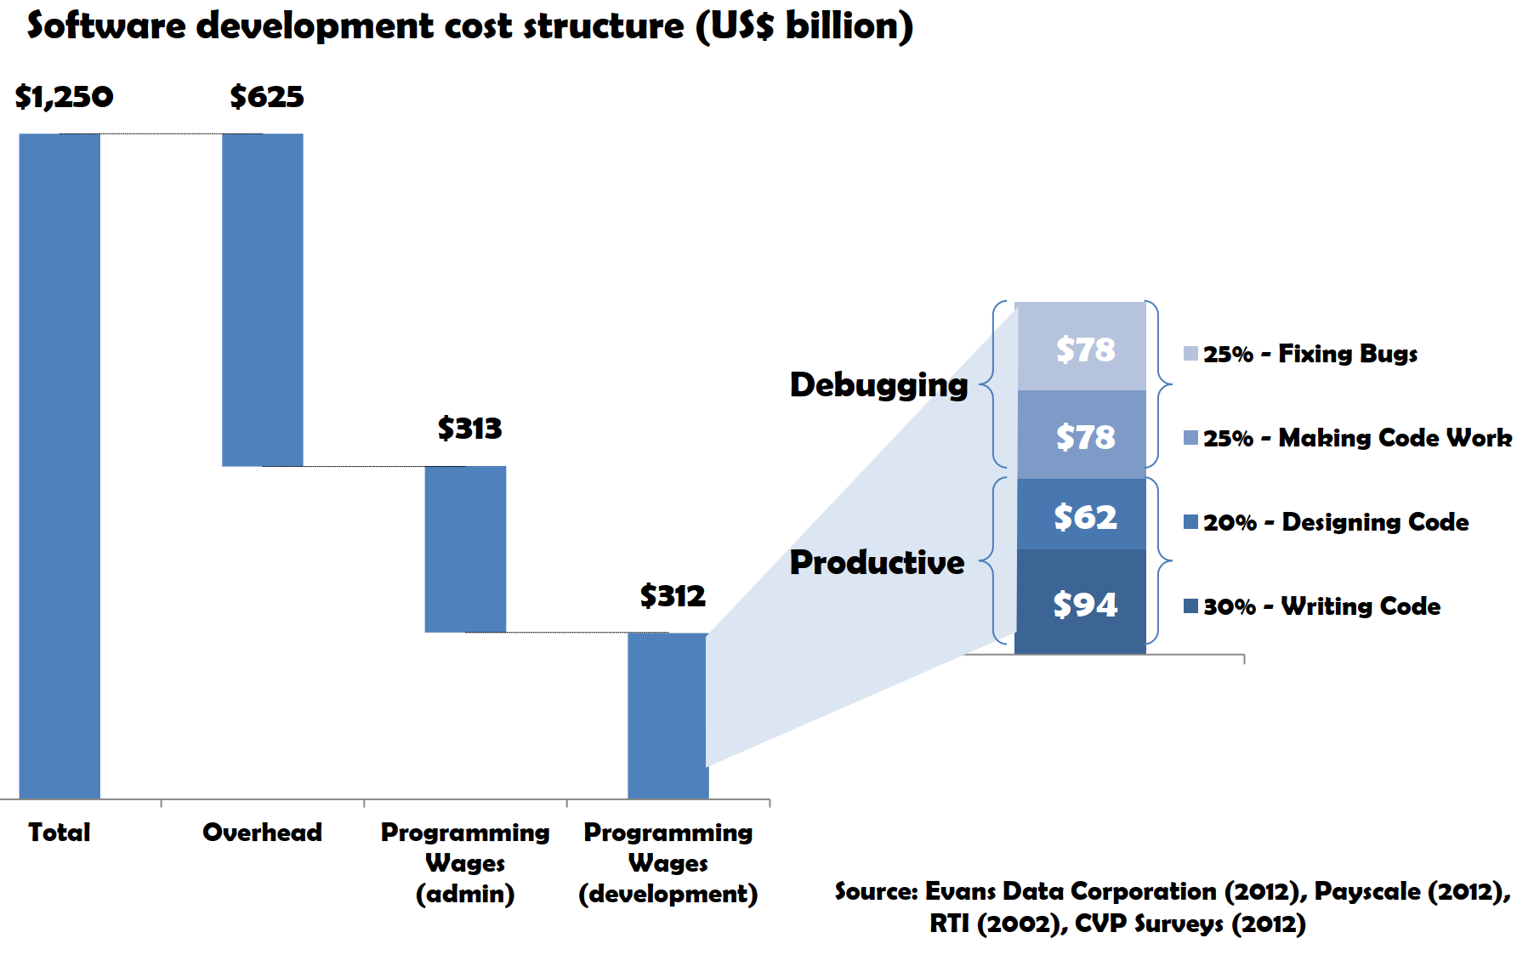
Quantification of the Global Costs Associated with Development
University of Cambridge Case Study
US$156 Billion per year Wages-only estimated cost of debugging
US$312 Billion per year TOTAL estimated cost of debugging including wages and overheads
Programmers Time
50.1% General Tasks & Development
49.9% Debugging
Projected Outcome(s)
Effective debugging technique(s) can save 26% in debug time
Net Global Savings Potential $81 Billion
Bottomline
We have opportunities
Reference: Britton, T., Jeng, L., Carver, G., Cheak, P. & Katzenellenbogen, T. (2013) Reversible Debugging Software: Quantify the time and cost saved using reversible debuggers
Source: Evans Data Corporation (2012), Payscale (2012), RTI (2002), CVP Surveys (2012)
Notes:
To start off the discussion, I wanted to show a study from Cambridge related to cost for developing software. In the context of our firmware systems today; we are closer trending to complexity in software design. The focal point of the slides is to highlight the necessary overhead associated with debugging costing nearly 1.56 Billion across the world. If we apply to projection to the expenses in NSG, we have significant opportunity to refocus developer time onto future technologies amplifying the growth potential.
*According to 54 questionnaire responses to the CVP survey and 11 interviews, based on the question ‘what percentage of your time is spent programming (e.g. designing, writing, testing, debugging etc.) compared with other tasks (e.g. admin, meetings, sales, etc)?’ Other tasks were then grouped as ‘admin’. **According to 54 questionnaire responses to the CVP survey and 11 interviews, based on the question ‘Of the time spent programming, what percentage of your time is spent on the following: (1)fixing bugs (2)making code work (3)designing code (4) writing code.’ (1) and (2) then were grouped as debugging.

Slide 24

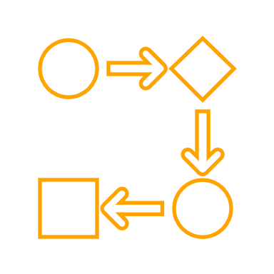










Problem Statement
Our debug/root cause and fix velocities are too slow
~6.5 days of effort to resolve each bug (spread over several weeks)
Our SSD devices are complex
Analysis (root-cause) requires a broad and deep understanding of FW/system
FW developers must spend time understanding context of bug or seeking expert council
Large number of issues to resolve strains expert availability
(Example) ADP program to date has seen just over 3,000 bugs
Hard to predict drive failures (asserts, perf, power, …)
We’re usually test-and-check
Notes:
In today’s performing state, it takes 6.5 days of effort to resolve bug and the timeframe to resolve it can linger for several weeks. The challenge is the resolution at its core is due to complexity of relational polices, mechanisms, exchanges, and events. As a consequence, the resolution requires a broad and deep understanding to address these faulting and anomalous states. The most optimized approach to solve these challenges are to develop task forces consisting of experts in various domains. To provide a background on the volume of the a given product program, we queried JIRA and were surprised to see over 3000 observed total bugs as of last week. The sheer volume explains the limited availability of experts and these were exposed through our continuous validation testing. The resolution of these were typically completed through the cycle of development, experiment, and re-testing with predicting outcomes ahead of time being on the order of complexity to solve the bug.
The impact of saving 0.1 person days of effort per bug (i.e. 0.8 person hours). Would yield 2,400 hours saved (0.8 person hours times 3,000 = 2400 person hours). When taking these into account a highly productive work week of 40 hours, we see on the order of 60 engineering weeks saved.

Slide 25






Environment Observation and Hypothesis
Observation
We are people, resource, and time constrained for BU expectations
Hypothesis
We can amplify our expert(s) capabilities and influence through automation
Agent(s)
Action(s)
State(s), Reason(s)
Situation(s)
Assessment(s)
Notes:
To summarize the findings of observation, we can see the active state shows a slow bug closure velocity, missed SLAs, and stretched project milestones/PRQs (David Roymoder). The takeaway is we are people, resource, and time constrained for the sustainable growth of the BU. The hypothesis is if we can amplify our expert’s capabilities and influence through automation then we can meet the expectations of the business unit entering the market sooner for our products.
An additional note is today, we do not have the ability to provide analytical confidence in product degradation without empirical execution. The human driven feedback has not been consistent; thus automation enables stabilization in resolution.

Slide 26
Challenge(s) in our Environment (Visualization)
Analysis, Experimentation, & Simulation
Data Control Management
Object ids
Git – Source Control
FW Source
FW Compiler
FW Binary
Test tools (Conval, PV, …)
Failures
JIRA
Telemetry binaries
Telemetry Extractor
Telemetry objects
Triage Tool
Likely root
causes
Dictionary of Telemetry Objects
Execution
Data
Crawler
Cross Language Compiler & Parser
Failures
Data Lake
Meta
Customer
Debug Handbook
Not used
Plenty of data is available (multiple firmware versions of telemetry) and it is not used ☹.
It is essential to automate analysis, methods, and conclusions to navigate in the ocean of data.
Notes:
With the environment today, we can see the directed acyclic graph above showing the interactions between our code, build system, execution, fault tracking system (JIRA), developer interactions, expert documentation, and our data lake (warehouse). The additions the telemetry effort has increased the automation capabilities in connecting the source code with our data through a centralized data management system. The addition of the cross language compiler means we can generate parsing scripts simultaneously with our firmware binaries to quickly interpret telemetry meta data in a standalone manner. The rapid interpretation is significant to exploit the live snapshotting capabilities of host initiated telemetry. The snapshotting provides developers with the key meta data on the device state such that we can load it into a simulator to probe system as if we were attached to a live device. With the debug handbook today, developers can take the state a use the documentation as a guide for resolving the issue. The beauty of the ecosystem we put in place with telemetry and customer engineering working group is as we encounter issues developers can share their knowledge, techniques, and critical thinking skills thereby enabling other developers to grow their own capabilities. The challenge of today’s state is we have a wealth of data without an easy way to navigate and analyze the relevant context. Our collaboration with our system integration team has enabled our triage tool to uses quite a bit of the data; however, the context is still limited due to the expert context not being automated.

Slide 27
Solution Vision
Reduced Human Analysis, Experimentation, & Simulation
Data Control Management
Object ids
Git – Source Control
FW Source
FW Compiler
FW Binary
Test tools (Conval, PV, …)
Failures
JIRA
Telemetry binaries
Telemetry Extractor
Telemetry objects
Triage Tool
Dictionary of Telemetry Objects
Execution
Data
Crawler
Cross Language Compiler & Parser
Failures
Likely root causes
Data Lake
Meta
Customer
Debug recipe
Debug Handbook
Execution, Defect Data
FW Sources
Likely root causes
Dev Analysis Modules
MP Engine(s)
Handbook Code
Codify the techniques listed in the debug handbook
Automated Analysis Reports to reduce human effort
(includes Expert Issue Context, Anomaly Prediction)
MP engines use fw-sources, defect info, debug-handbook, and extensive telemetry to generate automated analyses.
Notes:
The solution vision to resolve the ocean of data is use the handbook information to codify the techniques into expert analysis library modules, then use techniques in machine programming to reduce the scope. Once we have the scope reduced, we can then systematically use machine learning to determine relation of telemetry data, source code, JIRA, triage, and handbook analysis modules to train artificial intelligent agents to enhance the reports for developers. The interesting focal point to the vision is; while we continuously develop can we teach these agents to observe, identify, and predict the outcome of development in real time.

Slide 28




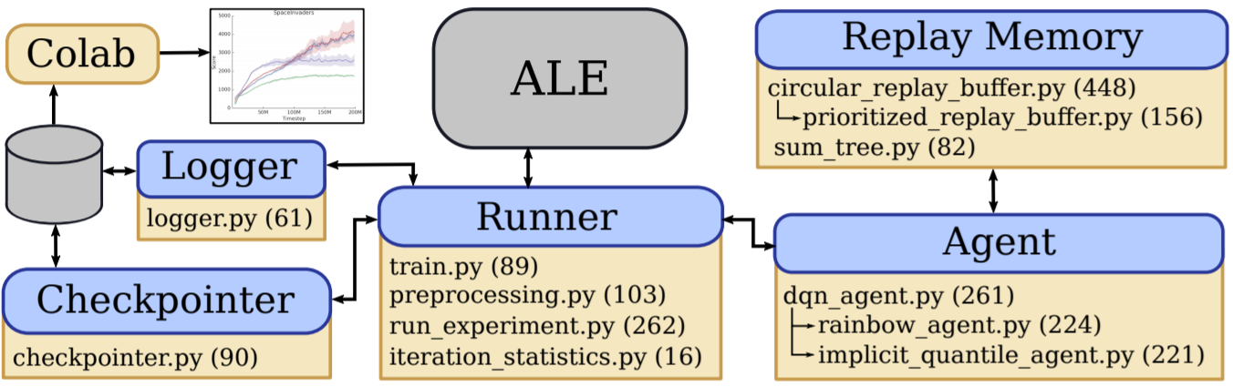



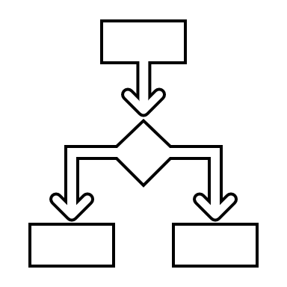

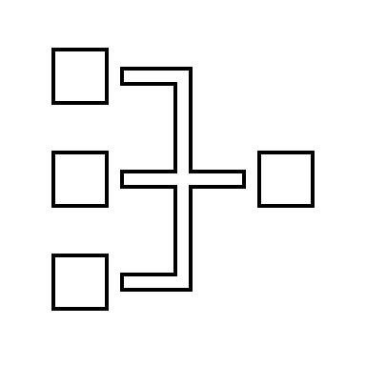


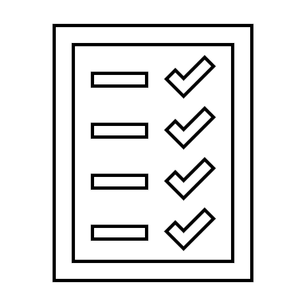


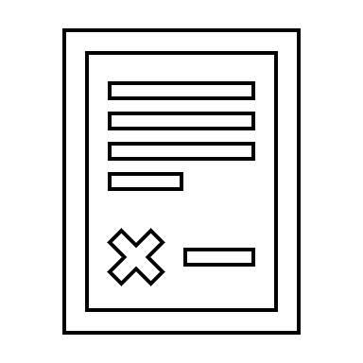
Application Plan for MP-Engine
Machine Programming Application
Telemetry Binary
Header | State
Table of Contents | Data List
Object(s) | Data State
Analysis Handbook
Entrance State | Assert, Bad Context, etc.
Significant Data Objects | Erase Table Band State
Methods to Evaluate Data | Erase Table to State List
Behavior Expectation | Interval, state, etc. ranges
I.E. Markov Decision Process (MDP)
Decode Telemetry
Identify Entrance Reference Graph
State(s) & Transition(s)
Action(s)
Bellman Expectation
Select Policy
Machine Programming
Report
I O %
S,T A %
S SP V
Castro, Pablo & Moitra, Subhodeep & Gelada, Carles & Kumar, Saurabh & Bellemare, Marc. (2018). Dopamine: A Research Framework for Deep Reinforcement Learning.
Intel® Nervana™ reference deep learning framework. https://github.com/NervanaSystems, https://www.intel.ai/reinforcement-learning-coach-intel/, https://software.intel.com/en-us/ai/courses/distributed-AI-ray
Notes:
The approach for the expert context is build on the machine programming semantics; specifically the Markov Decision Process. MDP consists of a starting state, set of states within firmware, set of actions on the state, possible transition, discount factor (expected cumulative future reward for final evaluation),
Bellman equations to characterize the vector table of states to all other states to use a: Monte Carlo, dynamic programming, Deep Q learning, etc., and finally construction of a policy to select for the MP engine to use in the report generation. The discount factor will take all actions based on short term and long term rewards to for mutate a probabilistic from trained features. The interesting features are these reflect the human analytical approach and is integrated with an agent based AI model to train expert based deep neural nets.

Slide 29
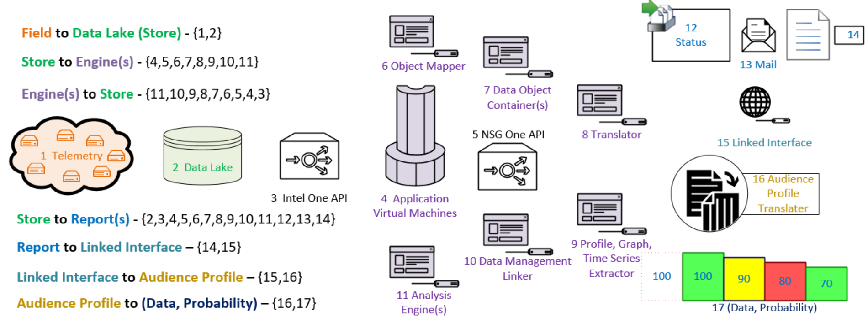
Solution Vision Framework
Share Framework with IT - Optimize for Enterprise
Notes:
The vision of the framework used the telemetry data piped through data lake to store all of the content. The content would then be accessed and put into the NSG API containers for virtual machine processing. The processing is expected to be completed in simple application modules in sequences to enable analysis, status updates, and audience profile targeting.
Collect all Telemetry binaries
Associated system meta data into Data Lake (DL)
Create NSG One container API
Extract, parse, map content, etc.
Streamline data into Intel’s One API to create applications
Access, search, cluster, etc. the data from DL to provide context
Create MP algorithms, capabilities, etc. (existing/create new)
Share Framework with IT
Optimize for Enterprise

Slide 30
References
Article(s)
https://itpeernetwork.intel.com/collect-or-not-collect/#gs.d2zakl
https://itpeernetwork.intel.com/telemetry-enhancing-customer-triage/
https://www.nvmedeveloperdays.com/English/Collaterals/Proceedings/2018/20181204_PRECON2_Hands.pdf
https://blogs.gnome.org/hughsie/2018/08/17/nvme-firmware-i-need-your-data/
https://lore.kernel.org/patchwork/patch/1072774/
https://manpages.debian.org/testing/nvme-cli/nvme.1.en.html
https://blocksandfiles.com/2019/08/02/burlywood-ssds-customised-workloadssd/
https://blogs.vmware.com/virtualblocks/2018/08/20/nvme-readiness-part-three/
https://www.supermicro.com/en/solutions/srsd
https://eric-keller.github.io/thesis/OliverMichel-dissertation_4_2019.pdf
https://arxiv.org/pdf/1803.07244.pdf
Wiki
Git
https://github.com/IntelLabs/DATSA
https://review.gerrithub.io/c/spdk/spdk/+/425191/
https://github.com/linux-nvme/nvme-cli
Matrix Profile, Prediction, Dynamic Point, and Optimizations
Extra
http://files.opencompute.org/oc/public.php?service=files&t=3963328530485f6e5944ba7ce4d1f8e3&download&path=/OCP%20-%20Adding%20Analytical%20Behavioral%20Intelligence%20to%20the%20Block%20Storage%20Lay....pdf
https://spdk.io/summit/us/2019/
https://www.cloudfest.com/wp-content/uploads/2018/03/01_Intel_CloudFest-Keynote-Das-Final.pdf?x86823
Notes:
On this slide, we have several references to the influential work within and around our BU.

Slide 31
Questions & Answers
The additional content is included to provide additional context and answers to potential questions.
The notes on the slides are to provide context for offline reading.
Please feel free to setup 1:1s to get deeper detail into any particular items.
We embrace the inclusion of additional ideas or approaches, so please feel free to discuss additions in follow up meetings.
“DellEMC will need to work closely with Intel to advance capabilities that will allow out of band telemetry features to support a spectrum of usage scenarios that have differentiating value. The usage scenarios include: known good state determination, advanced diagnostics, predictive failure identification, workload performance measurement and optimization, failure mode cause analysis, and autonomic management to list a few. Additionally, Intel support for a framework and capability that enables DellEMC embedded instrumentation and management to select and optimize telemetry acquisition and optimization for Intel provided components will enable a win-win situation where DellEMC compute platform offerings can target and tune the platform telemetry for specific environments and solutions.”
Elie Jreij VP, Fellow (DELL)

Slide 32
Appendix Material

Slide 33
Telemetry: Controller Initiated Telemetry (CiTAC)
Controller initiates a Get Log Page (0x08) on internal minor or major issue is detected (such as: event dump or
Assert dump) . Most other dynamic data is not current after a dump.
Always provide all 3 data areas (up to 31.9MB).
Drive States:
Non-Asserted Drive (including case of event dump)
Non-Asserted drive will only have data areas 1 and 2. Data area 3 is for Assert / event dumps.
Examples include but are not restricted to internal command time out, unrecovered data read, mis-compare or thermal threshold error
On an internal error, the drive indicates to Host it has a CIT Log available via the Asynchronous Event Request (AER) mechanism described in NVMe 1.3.
Asserted Drive
When drive Asserts, if still possible to talk to Host, the drive requests the Host to pull telemetry using either Get Controller Initiated Telemetry Log Page (0x08) or Get Host Initiated Telemetry Log Page (0x07).
Notes:
Bad Context Drive
Since we do know where the meta data are being located and how to recognize them, we can do physical scan of the media. This is only possible if the drive is not AES encrypted
llf() will recover the drive but host data will be gone.
You can do a scan for the parsePliDump on NAND drives to see if there are problem with PLI save and restore
You can examine the content of PliSlice on 3DXP drive to see if there is a problem with PLI save and restore.
Also based on the BAD_CTX number, FW guy can help deduce why the drive has gone into badctx
on NAND drive, you can do physical media scan to locate remnants fast context to extract the L2P table for closer examination
But this will take a lot of effort and results may vary.
The only way CIT would work is if you knew that you were about to get into a bad context situation.
Unfortunately in most cases, we don't have that much advanced warning. So our normal NAND storage is cannot help us.
Right now the plan is to use Sidetrace to provide enough information to discern what path we took to get into a bad context state.
Not much to be done for CIT.

Slide 34
Telemetry: Host Initiated Telemetry (HiTAC)
Host initiates a Telemetry data log file containing Data Areas (DA) 1-3 supported
Controller initiated is driven by either an event or Assert; which will be in the HIT if pulled.
Non-Asserted Drive
DA1 – Not to exceed 100KB for periodic data pulls
Intended for functional drive data performance / long term health monitoring
Customer sends DA1 snapshot log to drive vendor for assessment
DA1, DA2 & DA3: Full Log pull (Max Size = 31.9MB)
Used when Host detects an error the drive has not, such as QoS issue /Command Timeout
Asserted Drive
DA1, DA2 & DA3 – All data necessary to facilitate remote root cause debug resolution by Intel
Notes:
HiTAC is a customer controlled command to read any snapshotted data within any of the data areas for analysis.

Slide 35
Telemetry: Production and Processing Challenges
There Are Currently 288 Telemetry Objects Tracked
Evaluation for a single telemetry object creation from C to python C-type:
Avg case estimate for lines of python code using empirical constants (d = 4, z = 26)
(best = 296,064 avg. = 8,985,600, worst = 3,421,837,440)
=> 104 python code for one object parser on average
=> 104 x 188 (objects) = 29,952 lines of python for C-Type object definition
For each API, the C-Type, tracking information, and printer function:
29,952 x 3 = 89,856 lines
Multiple majors and minors for each object ctype, some with double digit majors and minor versions = > 8,985,600 lines of code for what we have to parse today!
Year | Operating system | SLOC (million)
1993 | Windows NT 3.1 | 4–5^{[2]}
1994 | Windows NT 3.5 | 7–8^{[2]}
1996 | Windows NT 4.0 | 11–12^{[2]}
2000 | Windows 2000 | more than 29^{[2]}
2001 | Windows XP | 45^{[3][4]}
2003 | Windows Server 2003 | 50^{[2]}
Note: The former process to add a data structure would take:
Incremental 3 days = least 3 years of work for all objects
New 2 weeks = >11 years of work for all objects
Notes:
Time Save Practically, O(3B) lines of code, Benchmark much more than Windows OS, unmanageable

Slide 36
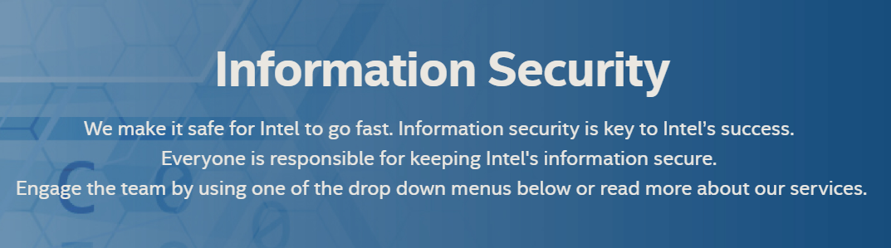
Telemetry: Security Data Classification
Guidelines - https://employeecontent.intel.com/content/corp/infosec/policies.html
Documentation - ssddev\nand\gen3\tools\telemetry\documentation
Security Risk Types
Data exposed to customers or the world.
Sensitive data relates to Intel secret or IP not protected by patent
Data object explanation
Each data structure should have a brief for the entire item and each element will need to be explained.
We need to list the units for each of the items with the base number I.E. base 2, base 10 mathematics, seconds.
Persistence type as defined by ePersistence in datacontrol.h I.E. constant, critical, lossly, reconstructed, etc.
NSG specific security context information
Security context information for the RNG/DRBG data. This includes ANY of the entropy data, DRBG internal data structures, etc.
Any of the firmware implemented algorithms such as CTR-DRBG
Any structure containing a user data payload with relation to admin commands, specifically security send a receive
I.E. DMT has an scx for SR so there the keys to the castle are there.
All key material data structures related to:
Fuse data containing things like the root key
PSID
Opal Passwords
UART passwords
TCG technology family (Opal, eSSC, Pyrite, etc.)
ATA security
Ephemeral keys
Plaintext keys in DRAM
https://employeecontent.intel.com/content/corp/infosec/home.html
Notes:
To ensure all data is secure, we developed a BKM to reassure security adherence.

Slide 37
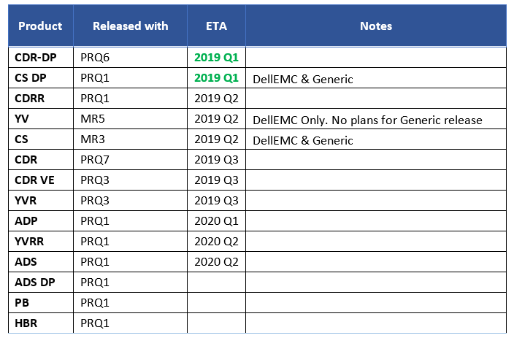
Telemetry: SSDs Intercepting with product release(s)

Slide 38
RAAD: Strategic Value
Aligns with 2019 TSLRP Machine Programming and 2020 TSLRP submission.
Embraces host system driven identification of anomalies to amend and mitigate them in the future
Enables engineers with domain analysis modules to increase org velocity (automate expert output)
High velocity automated context feedback mechanisms to provide insight to compress timelines for earlier PRQs and enhanced pathfinding
Shifts mindset of experts to reflect on methods of analysis for feature creation
Continuous learning model ensures we can analyze our ecosystem in a rapid manner
Enables design weaknesses detection from expert driven Meta data analysis to:
Feed forward and back propagation enabled us leap into future architectures in shorter timeframes embracing reconfiguration
Strengthens patents we have in our proprietary telemetry through technological advances
Notes:
The High velocity automated context feedback mechanism(s) provide insight to compress timelines for earlier PRQs and enhanced pathfinding. When embrace host system, we can drive identification of anomalies to predict, amend, and mitigate these in the future. The research and development enables detection of design weaknesses from expert driven Meta data analysis. The consequence is a leap into future architectures in shorter timeframes embracing reconfiguration. The R&D further solidifies our patents and propriety technology to best execute on Intel.

Slide 39
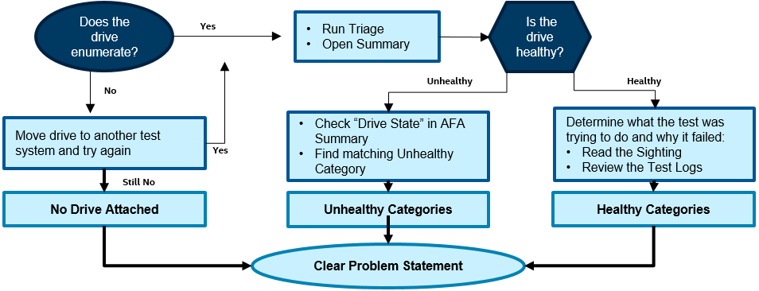
RAAD: Process for Staging Advanced Triage
Notes:
With all of the advancements, we are focusing on specific fault cases to show the feasibility of the frame work and lead by example in scientific evaluation.

Slide 40
RAAD: Technical Approach Plan
Enable IT Framework: Extend Intel One API for telemetry content in order to automate RAAD via MP.
Pick major fault (lead trunk product) and observe how it was solved by human experts.
Identify, gather, and use Telemetry required to provide auto expert context on the fault.
Automated expert analysis.
Train MP system(s) on that telemetry data.
Create benchmarks, verification, ROC (receiver operating characteristic), etc.
Repeat on a set of additional classes of issues and propose a general infrastructure.
Notes:
The technical plan is the once again focus on scalability through an API. The first set of focus points are addressing major challenges by using data to drive the highest impact. With all of the data we need to identify, gather, and effectively use the telemetry data to drive expert context. The expert context is critical to root cause faults; thus, if we can automate it we amplify the organization’s reach across the ocean of data. The MP system will require focused benchmarks, verification, and ROC for consistent data feedback from the applications. The process outline is constructed in a manner to be scalable for other challenges build on the adjacent context.

Slide 41
RAAD: Generalized Approach
Solution approach:
Apply successful techniques from scientific method.
Domain | Challenge | Solution
HAL | Thermals in Dual Port | Learned Approximate Profile (3 Slides Ahead)
Transport | Mailbox tracking of TAPs | Markov Decision Process (MDP) (Two Slides Ahead)
Core | Performance free space crash | Auto-Perf (Next Slide)
HAL | PMIC (Power management) | To be explored (TBE)
Media | NAND-Optane Stability | TBE
… | … | …
Tools | Compatibility of Data | TBE
Common | Code stability in Testing | TBE
Common | Debug Assert | TBE
Common | Debug Bad Context | TBE
Common | Performance Bottleneck | TBE
Learning Methods | Summary
Regression | Predict or explain a particular numerical value based on a set of prior data
Classification | Predict or explain a class value
Clustering | Group observations that have similar characteristics
Dimensionality Reduction | Remove the least important information
Ensemble Methods | Several predictive models to get higher quality predictions.
Neural Networks (NN) Deep Learning (DL) | Capture non-linear patterns in data by adding layers of parameters.
Transfer Learning | Re-using part of a previously trained neural net and adapting it to a new but similar task.
Reinforcement Learning | An agent learn from experience.
Natural Language Processing | Technique to prepare text for learning.
Word Embeddings | Numerical representations of text documents that only consider frequency and weighted frequencies.
Notes:
Definitions:
Root-cause analysis techniques (Module and system analysis)
Expert analysis of anomaly’s symptoms (Use modules to create audits of state)
The table on the left hand size shows the major domains, challenges, and potential solutions. At the moment, we have scoped potential candidates on the approach based on the machine learning methods listed on the right hand side.

